Slide 1

STUDENT DETAILS
NAME : AKULA SIRI
EMAIL ID: akulasiri214@gmail.com
COLLEGE : Talla Padmavathi college of Engineering, Telangana
DOMAIN: CYBER SECURITY

Slide 2

TITLE
DOS ATTACK USING NS2

Slide 3
AGENDA
MODELLING
RESULT
CUSTOMIZATION
SOLUTION
END USERS
Who are the end users of this project
What is the solution and its value proposition
What are the customizations performed
How different models are used
OVERVIEW
Overall conclusion of the dos attack.
Explanation of DOS and ns2

Slide 4
PROJECT OVERVIEW
2
1
3
DOS-ATTACK
NS2
PROBLEM STATEMENT
A denial of service (DOS) attack attempts to overwhelm a server, network, or website by flooding it with traffic.
NS2 is an open-source discrete event network simulator, which is widely used for research and education in the field of networking and communications.
Unsecured networks are vulnerable to DOS attacks, which can cause a system to crash and lead to data loss.

Slide 5

WHO ARE THE END USERS of this project?
DOS attack causes a complete or partial system outage. To overcome this phishing problem, we use NS2 simulator. As ns2 is a network simulator, it traces the computer communication network.
Using ns2 simulator we trace the network connected to the computer system. It generates the network packets using network topology.
The network topology in ns2 simulator results in the data packets of network transmission.
The DOS attack results in the trace files of network connected and gives the list of data packets containing trace values of the connection.
The end user can get rid of the DOS attack using NS2 simulator as it simulates the network connected and enables the user to get secured network connection to the system.

Slide 6
YOUR SOLUTION AND ITS VALUE PROPOSITION
topic
solution
DOS attack using NS2 simulator.
This simulator designed for research in computer communication networks.
DOS is the Denial of Service.
As DOS is an attack that causes the partial outage of system, we resolve this type of problem using NS2 simulator. It researches the network connected to computer and finds the data packets, trace files through which we can stop the DOS attack.
Need of solution
Value proposition
The network topology created in the simulator creates data packets and trace files. It lists the data connected to the computer and analyses the network. DOS files created with network topologies helps to trace the network animator(NAM) files. It helps the user to identify the data packets, with which a user can simulate the network.
DOS attack using ns2 simulation, it brings the user an idea of how a simulator works, how the dos attack is performed, how the network topologies can be used in this project, and tracing the network files, data packets.

Slide 7
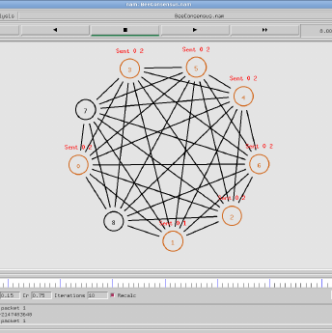

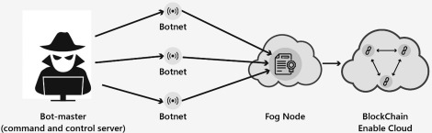
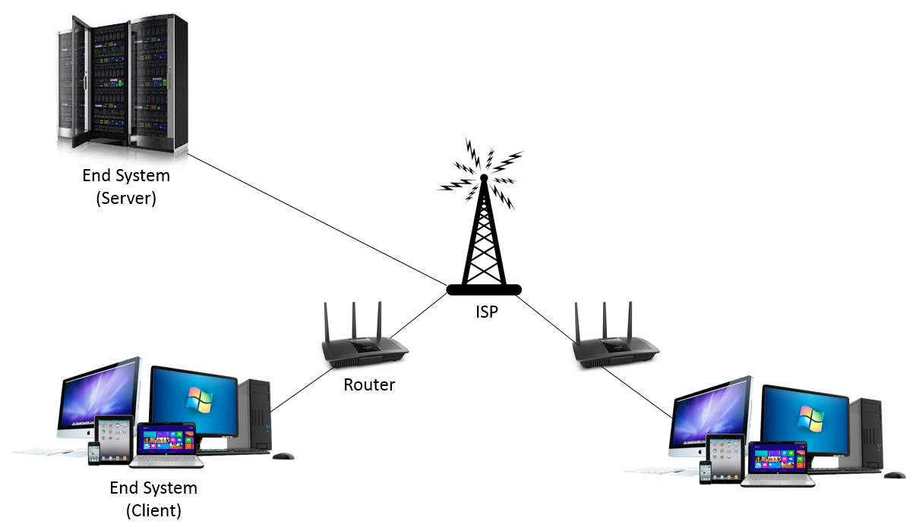
How did you customize the project and make it your own
CCS
protocols
simulator
software
Command and Control Server. It is a control based server, which connects the botnet to the cloud .
TCP and UDP are the two protocols which we have used in order to trace the simulator and animator
NS2 simulator however simulates the network connection, we utilize it to generate the NAM and trace files in order to track the network data packets.
For a particular instance to be done we need specified software which can perform our required task. Here we use UBUNTU, through which we can easily edit the TCL files.

Slide 8
MODELLING
techniques
framework
principles
The simulator and the animator are the two specialized techniques used in order to gain the network data.
A typical virtual software is updated and install the UBUNTU package. Using TCL editors we execute the scripts in order to gain the trace files of the network.
The network principles and the related script conditions are used to get the output without an error. In the technology we use terminals for the updated and error free data that to be shown.

Slide 9
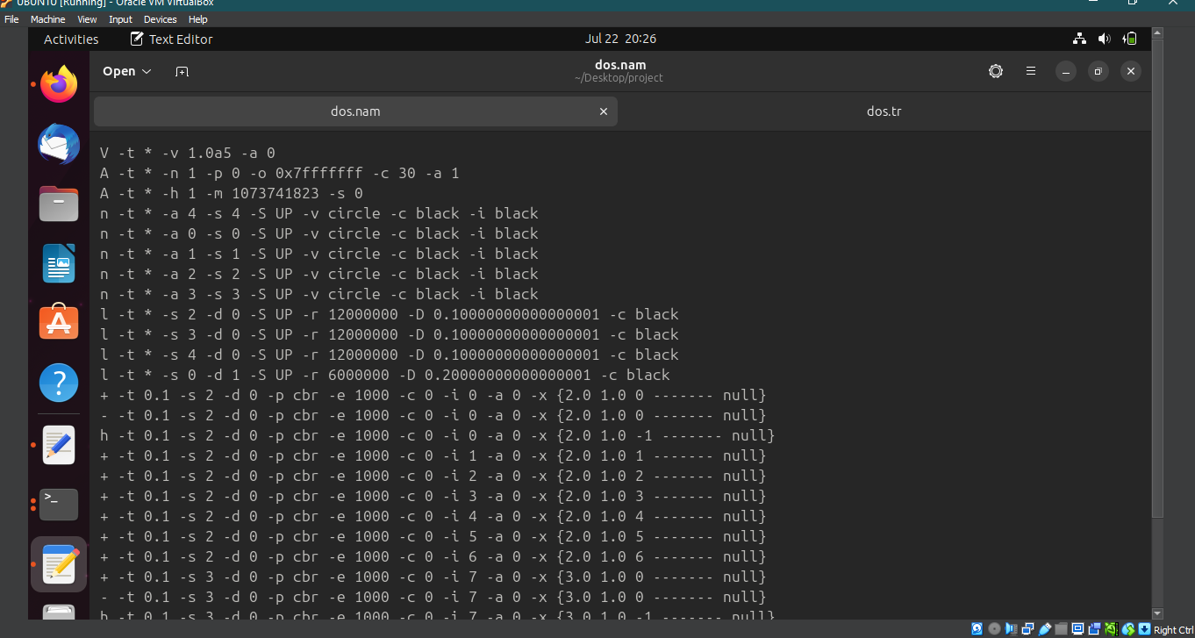
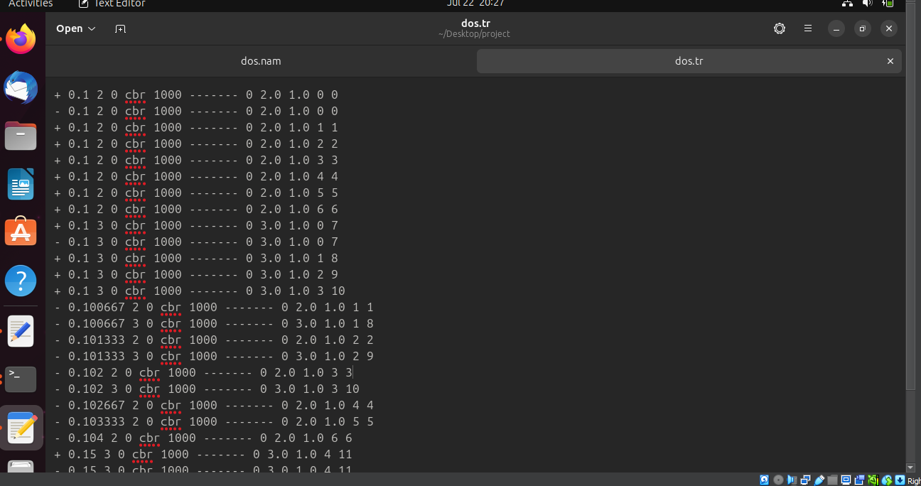
RESULT :
The dos.tcl files after running in the ns2 command prompts. We get the log files of dos.nam and dos.tr having the data packets sent and received from target nodes.
dos.nam
dos.tr

Slide 10

links
sr14a/dos-attack: DOS - Denial Of Service attack is a type of attack that causes a complete or partial system outage. In this project we perform DOS attack using NS2 in the field of cyber security. (github.com)
The link provided gives the input and output for the dos attack using ns2 project. It directs to GITHUB profile.
DOS attack using ns2 gives the trace files of the data packets that are sent and received from the target node.

Slide 11


THANK YOU
-AKULA SIRI

